Slide 1
SAC Debate: National Menorah
Secondary Learners
Winter 2023

Slide 2
Warm Up
On a piece of scrap paper, reflect:
What do you know about this clause of the US Constitution?
What does it mean to you? Try putting it in your own words.
Why is it important?
Congress shall make no law respecting an establishment of religion, or prohibiting the free exercise thereof.
Constitution of the United States, Amendment 1

Slide 3
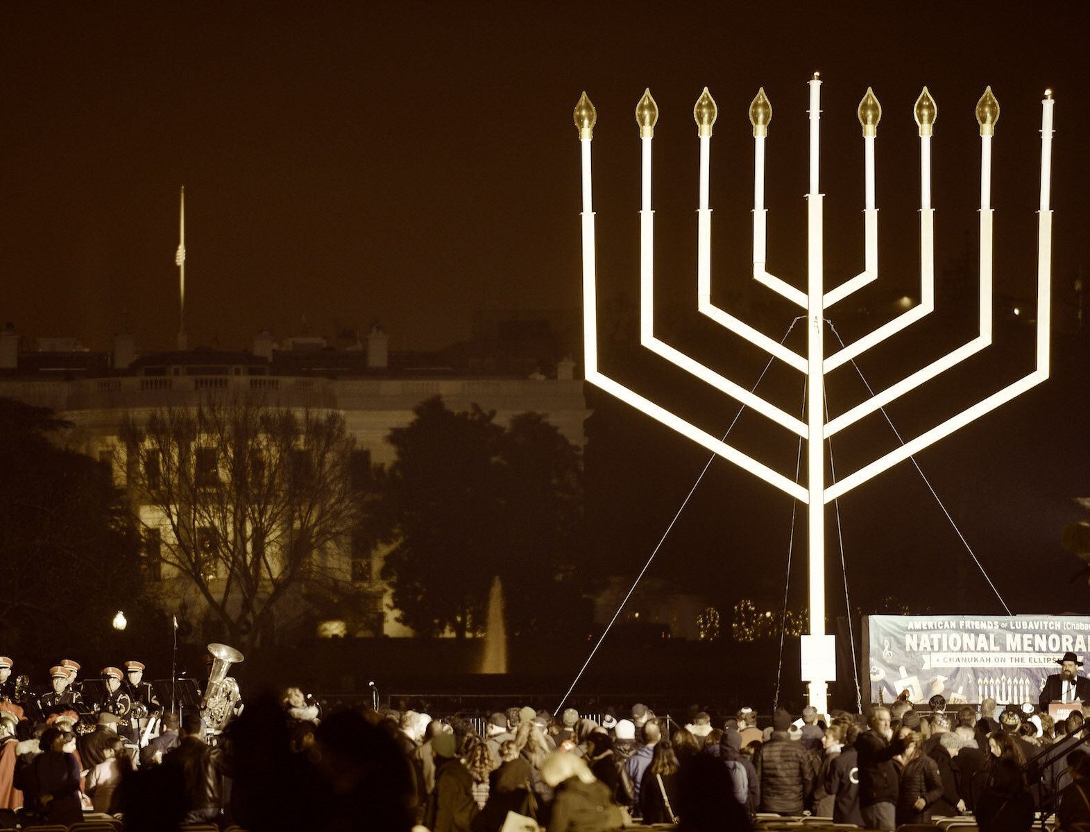
Today’s Agenda
Warm Up
Review Background Knowledge
Structured Academic Controversy: Should the United States have a National Menorah?
Closing: Written Response
Notes:
Image Source: https://www.jta.org/archive/carter-dedicates-menorah-in-historic-chanukah-ceremony

Slide 4
Background Knowledge
Hanukkah is an 8-day Jewish festival celebrating an ancient miracle.
In 164 BCE a group of Jewish warriors called the Maccabees fought for religious freedom from the oppression of King Antioch. Tradition holds that even the Jewish Temple was in ruins, a small amount of oil burned for 8 days straight, allowing the Temple to be cleansed and rededicated.
On each night of Hanukkah, Jewish families and communities light an additional candle on the Menorah to remember the miracle of the oil.
Notes:
Image credit: https://prologue.blogs.archives.gov/2013/12/04/from-the-presidential-libraries-hanukkah-at-the-white-house/

Slide 5
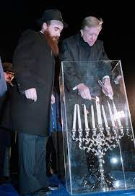
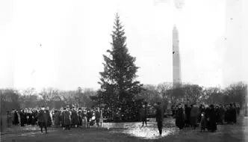
Background Knowledge
Worth noting: The United States has had a National Christmas tree every year since 1923 (pictured below) and each of the 50 states has erected a tree in the same park since 1954.
In 1979, US President Jimmy Carter lit the first National Menorah on White House grounds in Washington, DC to celebrate Hanukkah (pictured right), and there’s been a National Menorah alongside the Christmas Trees every year since.
Notes:
Image credit: https://prologue.blogs.archives.gov/2013/12/04/from-the-presidential-libraries-hanukkah-at-the-white-house/
Source and image: Source: https://www.nps.gov/whho/learn/historyculture/national-christmas-tree-history.htm

Slide 6
STRUCTURED ACADEMIC CONTROVERSY: Should the United States have a National Menorah?
In this activity, you and a partner will be assigned a position in this debate. You’ll read and work through a set of documents to back that position, and then debate it with another set of partners on the other side. Then, once you’ve had a chance to really interrogate and understand both sides, we’ll wrap up with an independent writing task to demonstrate your own thoughts on this question.

Slide 7
Should the United States have a National Menorah?
Side A | Side B
Yes, the United States should have a National Menorah. | No, the United States should not have a National Menorah.
I) Prepare the evidence (20 minutes)
Read the documents once through together.
Read the documents a second time and identify evidence that supports your assigned side of the argument.
Fill out your Evidence Sheet with quotes from the documents and be sure to include explanations of how those quotes support your argument.
Develop in your own words the thesis of your argument and write it at the bottom of your Evidence Sheet.
Practice the clear delivery of your thesis, along with the best evidence and explanations. Craft your position thoughtfully and anticipate counterarguments.

Slide 8
Should the United States have a National Menorah?
Side A | Side B
Yes, the United States should have a National Menorah. | No, the United States should not have a National Menorah.
II) Conduct the Controversy (10 minutes)
Side A presents their argument using the evidence they collected on the Evidence Sheet. Side B takes notes on Side A’s presentation on their Evidence Sheets. (4 minutes)
Side B presents their argument using the evidence they collected on the Evidence Sheet. Side A takes notes on Side A’s presentation on their Evidence Sheets. (4 minutes)
Controversy! Question each other, evaluate the sources, introduce new analysis. (2 minutes)

Slide 9
Should the United States have a National Menorah?
Side A | Side B
Yes, the United States should have a National Menorah. | No, the United States should not have a National Menorah.
III) Consensus-Building (5 minutes)
Drop your assigned side – you are no longer arguing the sides of the debate, but rather working as a group of 4 to fully understand both sides of the question at hand.
Find points of consensus or agreement regarding the question (or at least clarify what specific points are at issue between the sides), using supporting evidence. In other words, what can both sides agree on?
List these points of agreement and specific disagreement at the bottom of the Evidence Sheet.
Consider: What evidence did you personally find the most convincing?

Slide 10
Closing – What do you think?
You’ve now considered evidence on both sides of this debate.
To wrap up today, write a one paragraph response to the Essential Question: Should the United States have a National Menorah?
Your response should include:
A clear thesis statement answering the question
Specific evidence from the documents
Clear reasoning and analysis

