Slide 1
Spread the Light
Elementary Learners
Winter 2023

Slide 2
Activate!
What objects do you see in this picture?
What might this girl be doing?
Do you recognize anything in this image?
What do you think she is thinking or feeling?
What questions might we ask about this photograph?
Notes:
Photo credit: Lloyd Wolf (1995). Courtesy of the Capital Jewish Museum collection

Slide 3
Hanukkah
Jewish families celebrate Hanukkah by lighting the candles on this special lamp called a Menorah.
This girl is celebrating Hanukkah, the Jewish Festival of Lights. Her name is Emma!
Emma is using the shamash, the tallest candle, to light the rest of the candles.
Notes:
Photo credit: Lloyd Wolf (1995). Courtesy of the Capital Jewish Museum collection

Slide 4
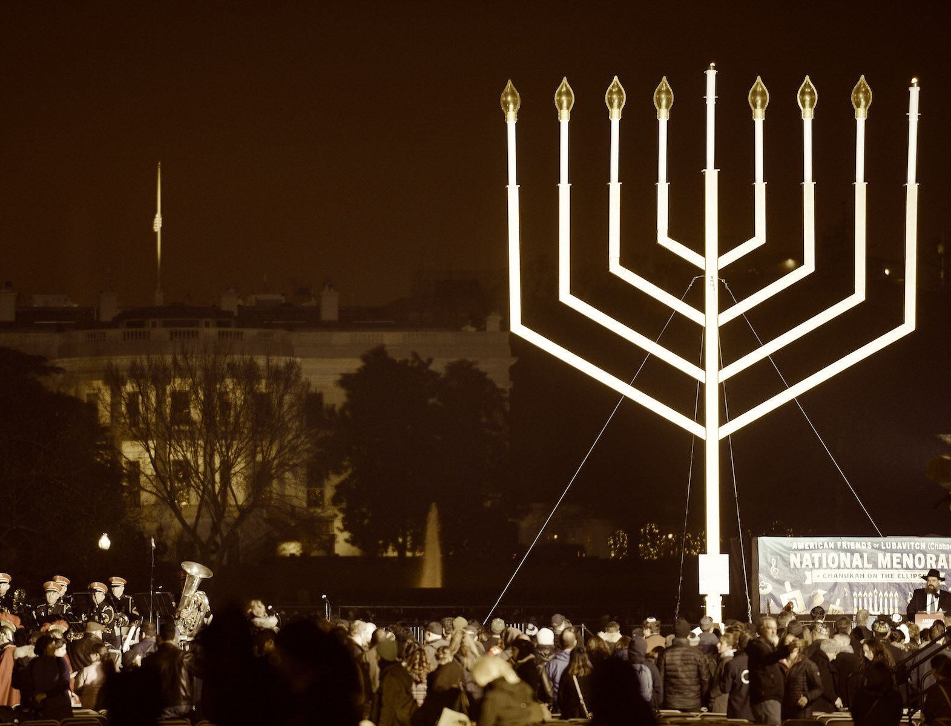
Today’s Agenda
Activate!
Read and Learn about Hanukkah
Brainstorm: How can I be a shamash?
Notes:
Image Source: https://www.jta.org/archive/carter-dedicates-menorah-in-historic-chanukah-ceremony

Slide 5
What is Hanukkah?
Hanukkah is an 8-day Jewish festival celebrating an ancient miracle.
Long ago, Greek rulers didn’t want Jewish people to be able to celebrate their Jewish religion. A group of Jewish warriors called the Maccabees fought for their religious freedom. They wanted to be able to be Jewish without harassment or violence from the King. The Maccabees were able to defeat the King and gain their freedom, but the Jewish Temple had nearly been destroyed. According to tradition, a very small amount of oil burned in the Temple’s Menorah for 8 days, which was enough time to clean the Temple and make more oil. A miracle!
On each night of Hanukkah, Jewish families light one more candle on the Menorah to remember the miracle of the oil and the Maccabees.

Slide 6
Read and Learn!
How do Jewish families celebrate Hanukkah?
As we read this book together, find details to help you answer this question!

Slide 7
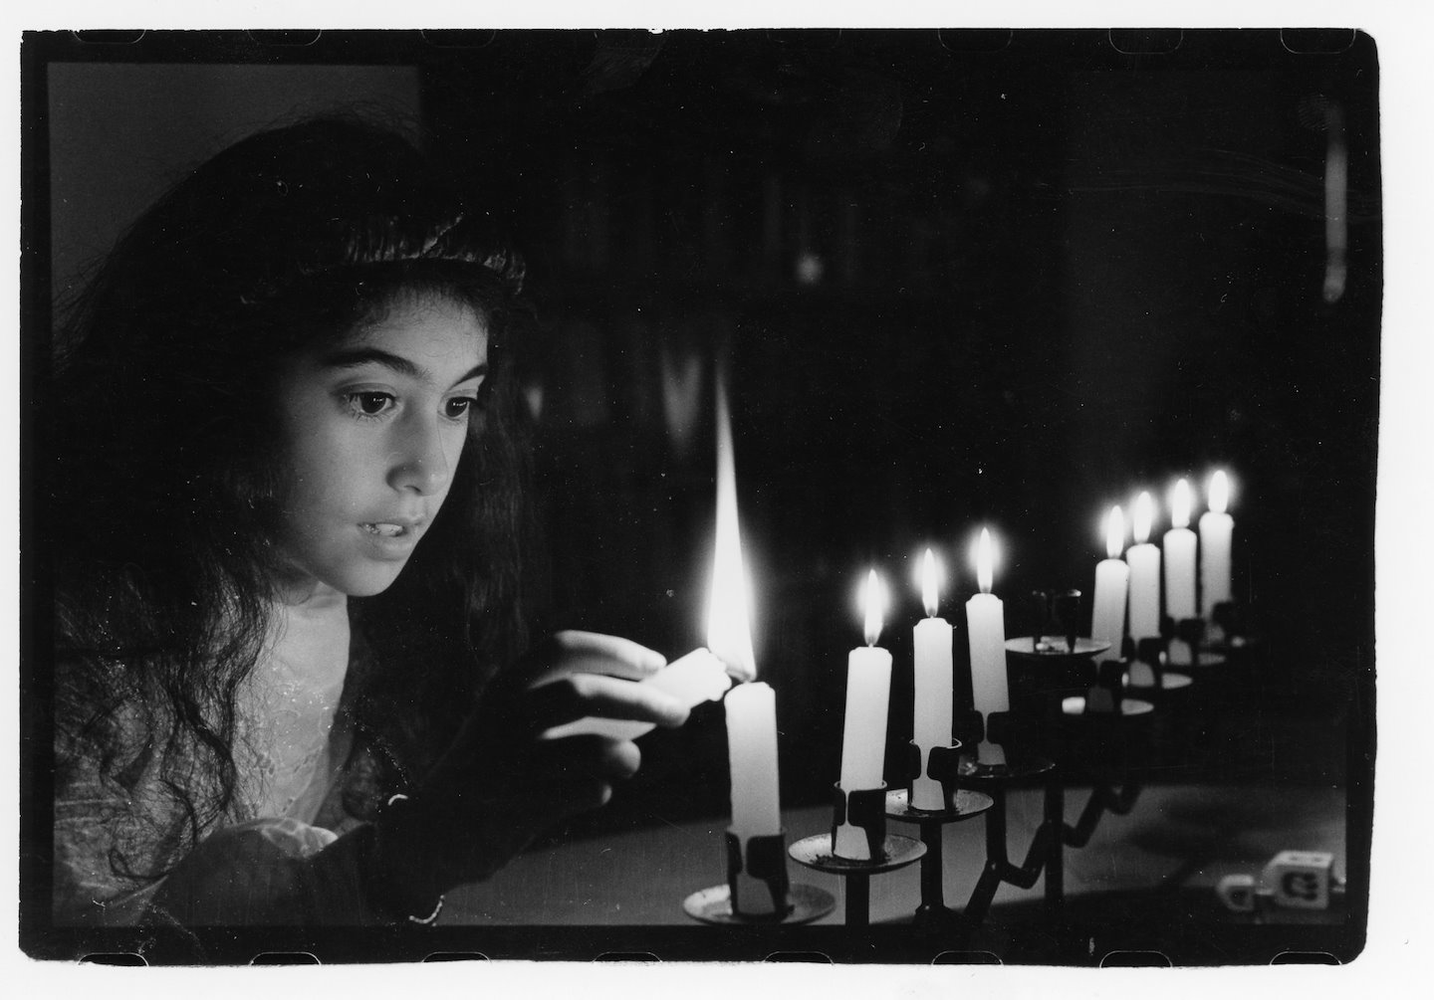
What is the shamash?
How many candles do you see in this picture?
Recall: How many nights of Hanukkah are there?
Bonus! Which night of Hanukkah is this?

Slide 8
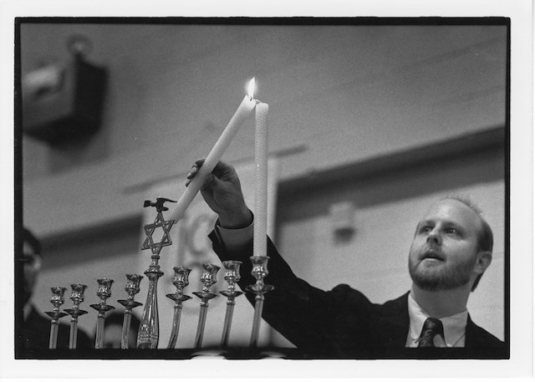
The Shamash is the Helper Candle
See how he uses the shamash, the tallest candle in the middle, to share light with the candle on the end.
Does the Shamash’s light go out when it’s used to light the other candles?
Bonus! Which night of Hanukkah is this?
Notes:
Photo taken by Lloyd Wolf, courtesy of Capital Jewish Museum collection

Slide 9
How can I be a shamash?
Brainstorm
Color
Display

Slide 10
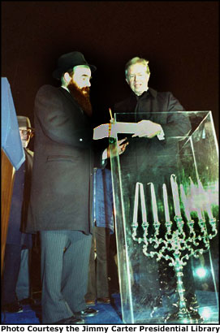
For Example…
In 1979, President Carter lit the first National Menorah across the street from the White House to celebrate Hanukkah. In the image to the right, you can see that the candles are protected from the wind inside the plexiglass box. Do you think it would be easy to light a candle inside of the box? Why?
It wasn’t easy! The matches were too short to light the candles, so a Secret Service Agent was sent to find longer matches. A nearby store, owned by a Jewish family, happened to have a specialty matchboxes with 8- inch matches.

Slide 11
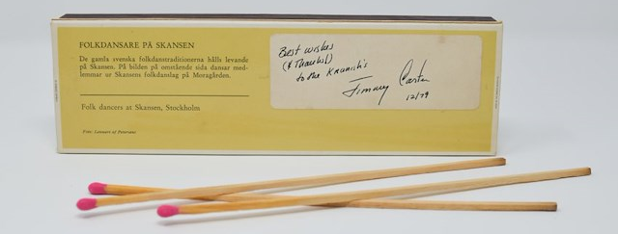
For Example…
The long matches were the perfect length to reach inside the box and light the candles.
President Carter signed the match box and gave it back to the store owners as a thank you.
Notes:
Photo courtesy of the Capital Jewish Museum

Slide 12
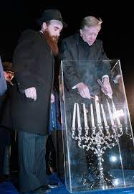
How to be a Shamash:
The shop owners were a shamash when they shared their long matches – they helped President Carter share the light of Hanukkah.
President Carter was a shamash when he signed and gave the matchbox back to the shop owners with a thank you.
Notes:
Image credit: https://prologue.blogs.archives.gov/2013/12/04/from-the-presidential-libraries-hanukkah-at-the-white-house/

Slide 13
Brainstorm: How can I be a shamash?
What are ways that you share your light by helping others?

Slide 14
Make Your Own Menorah to Spread the Light
Gather your materials and put a blank sheet of white paper in front of you.
Cut out a long strip of construction paper and glue or tape it along the bottom of your white paper. This is your Menorah.
Cut a medium strip of construction paper and tape or glue it in the middle of the Menorah, so it sticks up like a candle. This is the Shamash.
Put your name on the Shamash! You are the helper.
Jimmy
Jimmy

Slide 15
Make Your Own Menorah to Spread the Light
4) Cut 8 more candles out of the construction paper, shorter than the Shamash.
5) Write one way you can be a helper on each candle, and tape or glue them to either side of the Menorah.
Hint: use the class brainstorm to help you think of ideas to fill your Menorah with ways you can spread the light.
Jimmy
Jimmy
Return a matchbook thankfully

Slide 16
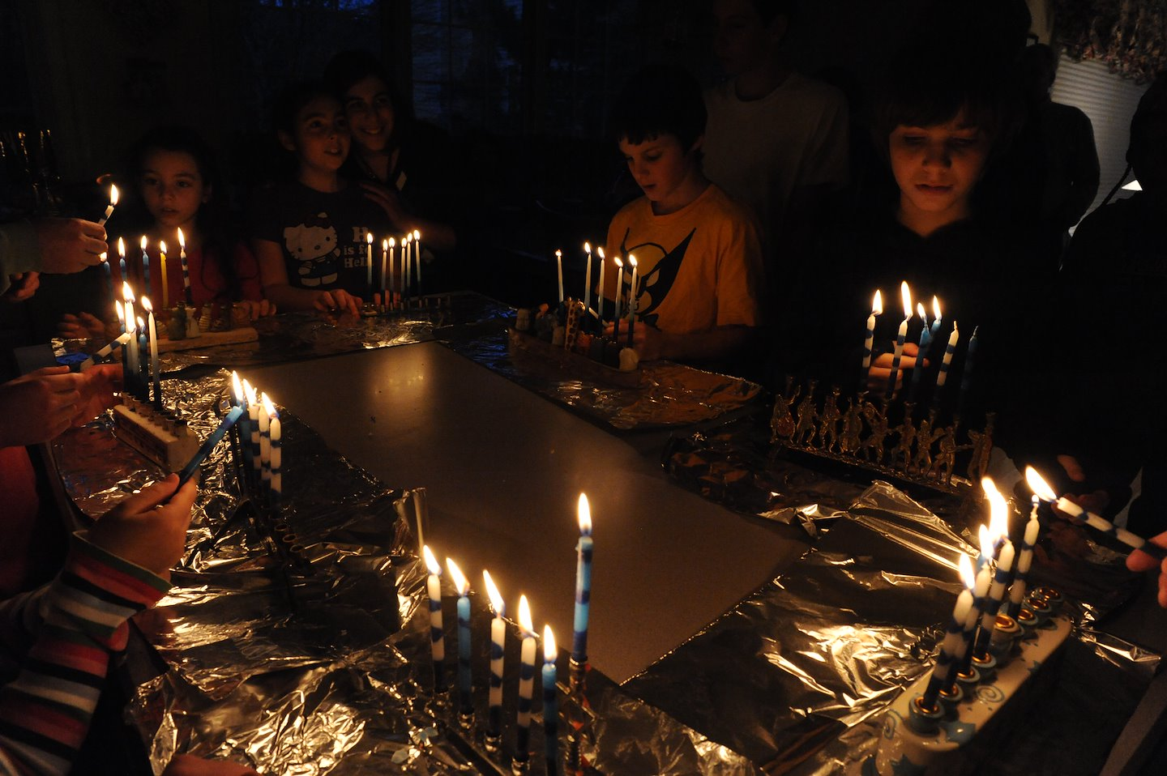
You are all Helper Candles!
Take a few minutes to look around the room at all the different Menorahs. Which ones are similar to yours? Who had different ideas?
No matter who you are or how you are a Helper, continue to share your light all holiday season!
Notes:
Photo credit: Lloyd Wolf. Courtesy of the Capital Jewish Museum collection

